Slide 1
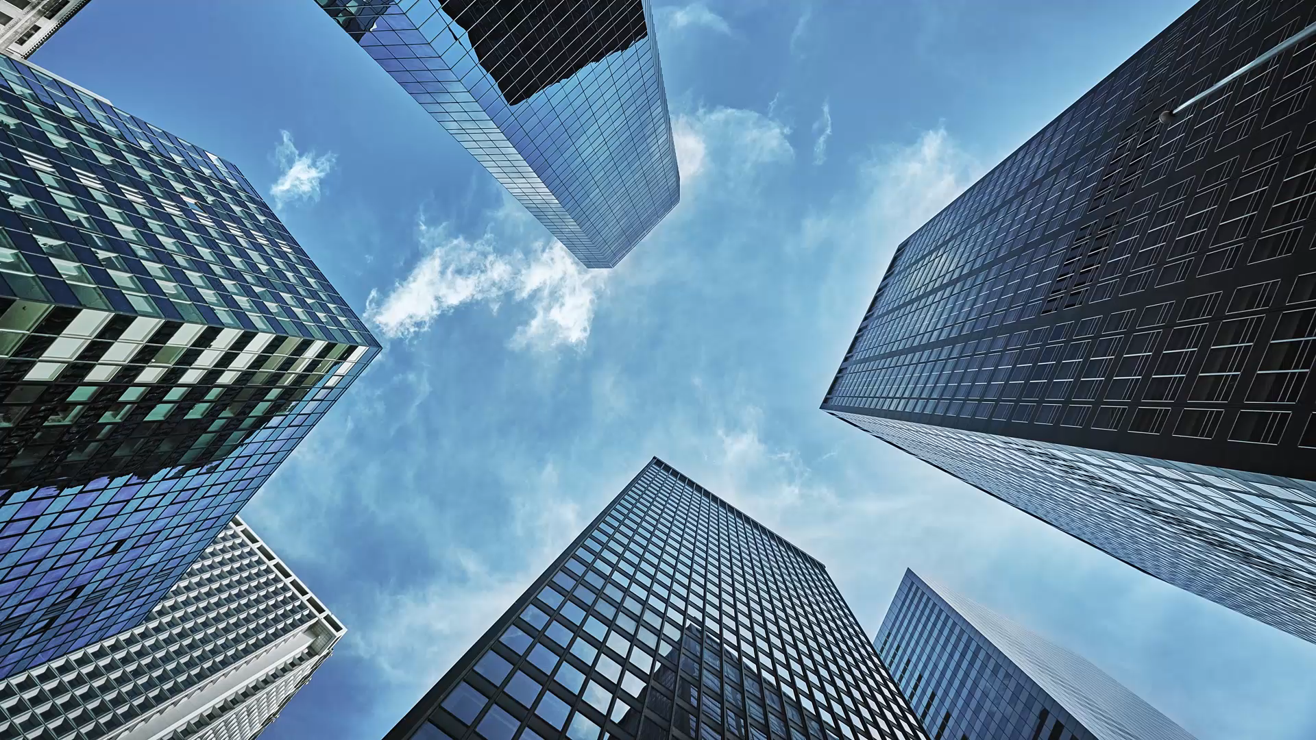
Similarity between Downtown, Toronto and Manhattan from a Tourist point of view
Gayathri Vinnakota

Slide 2
Introduction
Goal: To determine how similar Downtown Toronto, Canada and Manhattan, New York are when it comes to tourism.
It will
Assist tourists by providing them with the information needed to travel, comparing two place.
Help them make a decision depending on their choice or priority.

Slide 3
Data Acquisition and Cleaning
For Downtown Toronto, we will web scrape city data from https://en.wikipedia.org/wiki/List_of_postal_codes_of_Canada:_M
For Manhattan, New York city data available at https://geo.nyu.edu/catalog/nyu_2451_34572.

Slide 4
Exploratory Data Analysis
Extract Data of Toronto from Wikipedia and New York from the New York University webpage.
Combine neighborhoods of each dataframe that have the same geographical coordinates at each borough and sorted against the concerned borough.
Use Foursquare API for data verification and to get the coordinates of Downtown Toronto and explore its neighborhoods.
Characterize the neighborhoods as venues and venue categories.

Slide 5
Methodology
Focus on Manhattan, New York, and Downtown Toronto from data extracted using the webpages and the Foursquare API services.
K-means Clustering machine learning algorithm to compare the two places Manhattan, New York, and Downtown, Toronto, and find the similarities.
One hot encoding is used to calculate the mean of each neighborhood’s frequency of occurrence in Downtown Toronto and Manhattan to measure the foot traffic in these places.

Slide 6
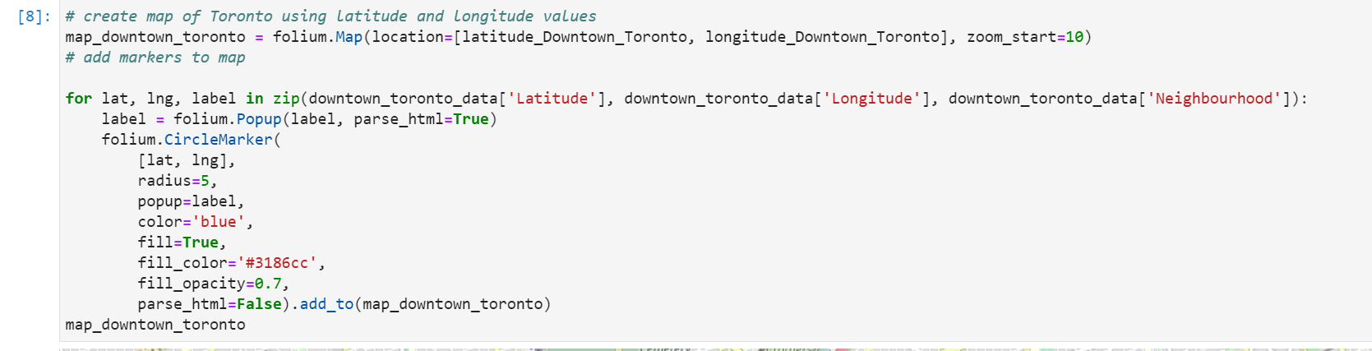
Downtown Toronto Before Clustering

Slide 7
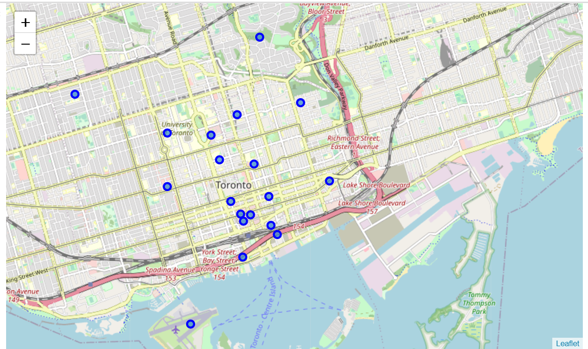
Downtown Toronto Before Clustering

Slide 8
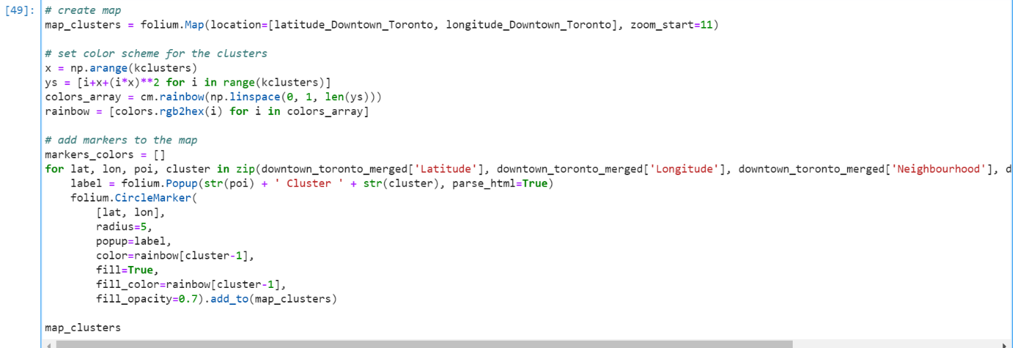
Downtown Toronto After Clustering

Slide 9
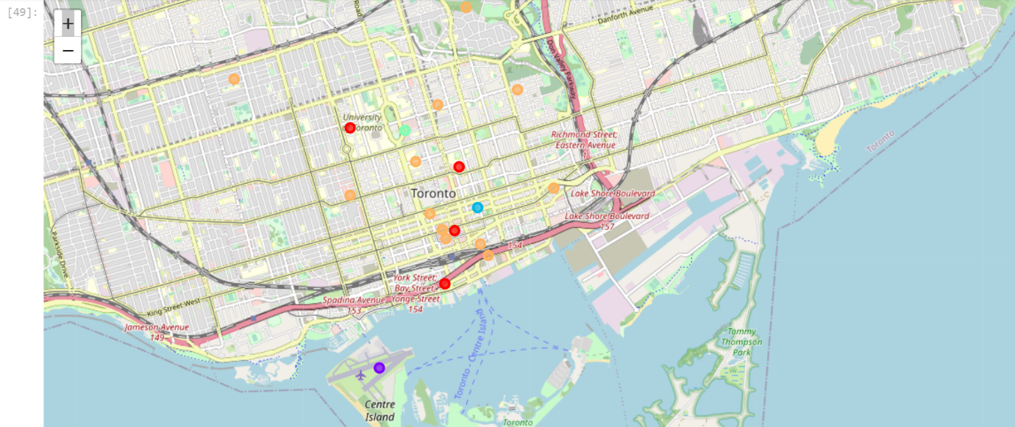
Downtown Toronto after Clustering

Slide 10
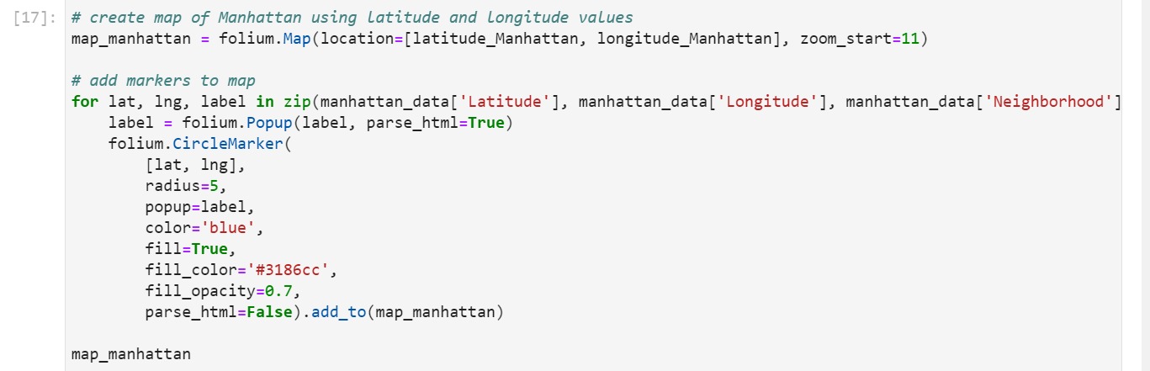
Manhattan Before Clustering

Slide 11
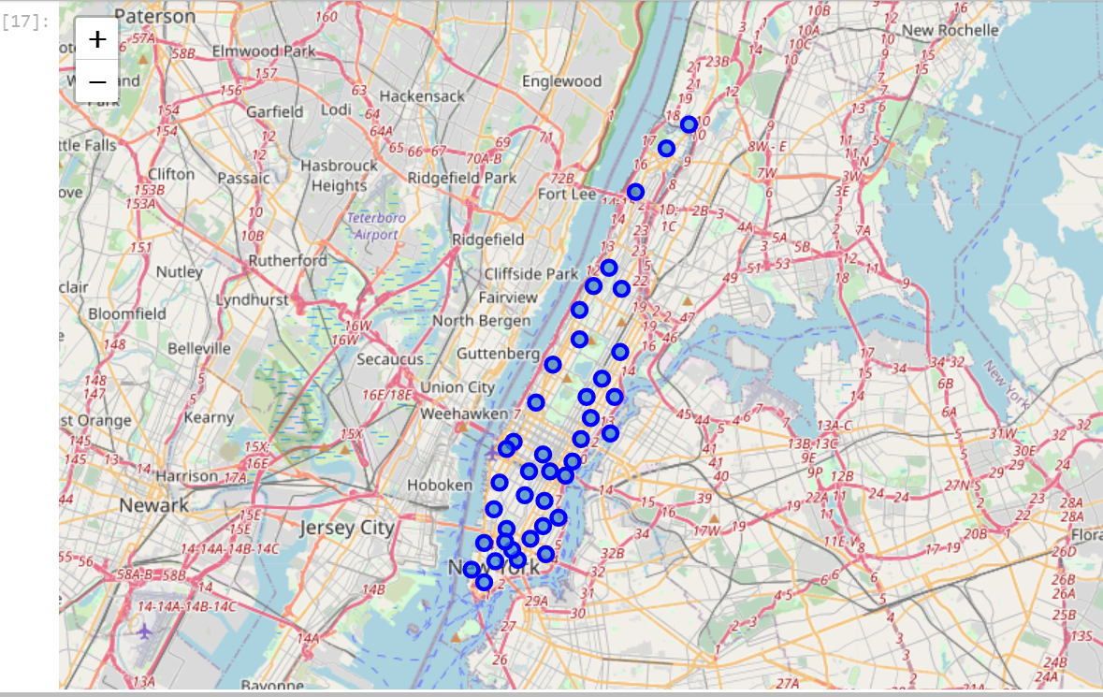
Manhattan Before Clustering

Slide 12
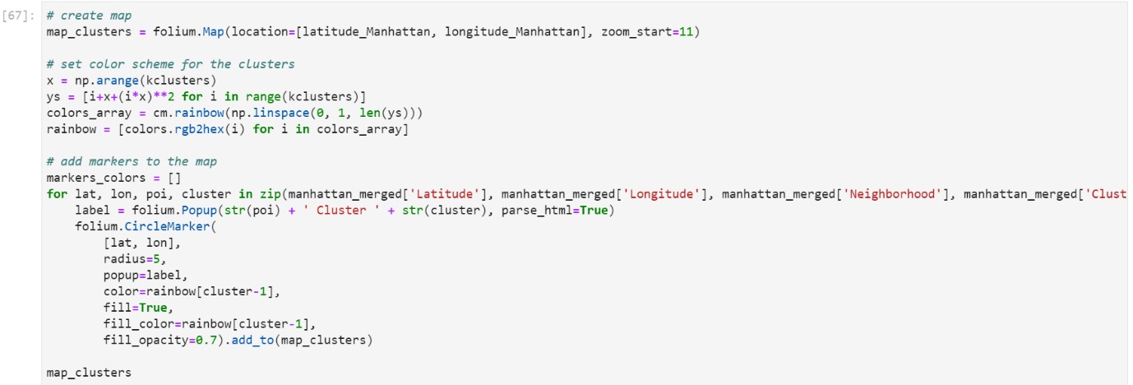
Manhattan After Clustering

Slide 13
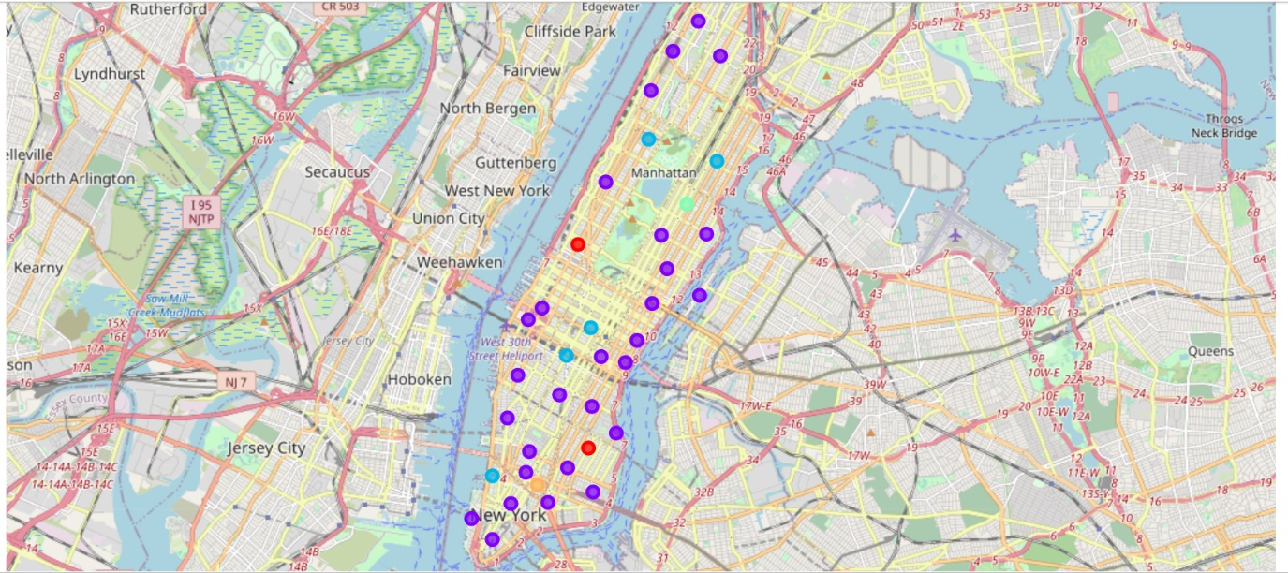
Manhattan after Clustering

Slide 14
Results
Downtown Toronto and Manhattan, New York both the places have venues that tourists would be attracted to explore.
The neighborhoods are similar to venues like Theaters, opera houses, food places, clubs, museums, parks, etc.
The only dissimilarity is that their unique historical places and monuments.

Slide 15
Observations
Downtown Toronto has Historical places and Airport facilities, a harbor, a Sculpture garden, and ferry services.
Manhattan has monument or landmark venues, Nightlife, Climbing gym, and Museums.

Slide 16
Recommendation
Downtown Toronto will be a tourist's priority to visit. This is because the airport facility is available in Downtown Toronto which saves time but also saves money.

Slide 17
Conclusion
Downtown Toronto and Manhattan neighborhoods have similar venues except the historical venues which are unique.

Slide 18
Thank you

